Slide 1




Staff Meeting
10.14.2024

Slide 2

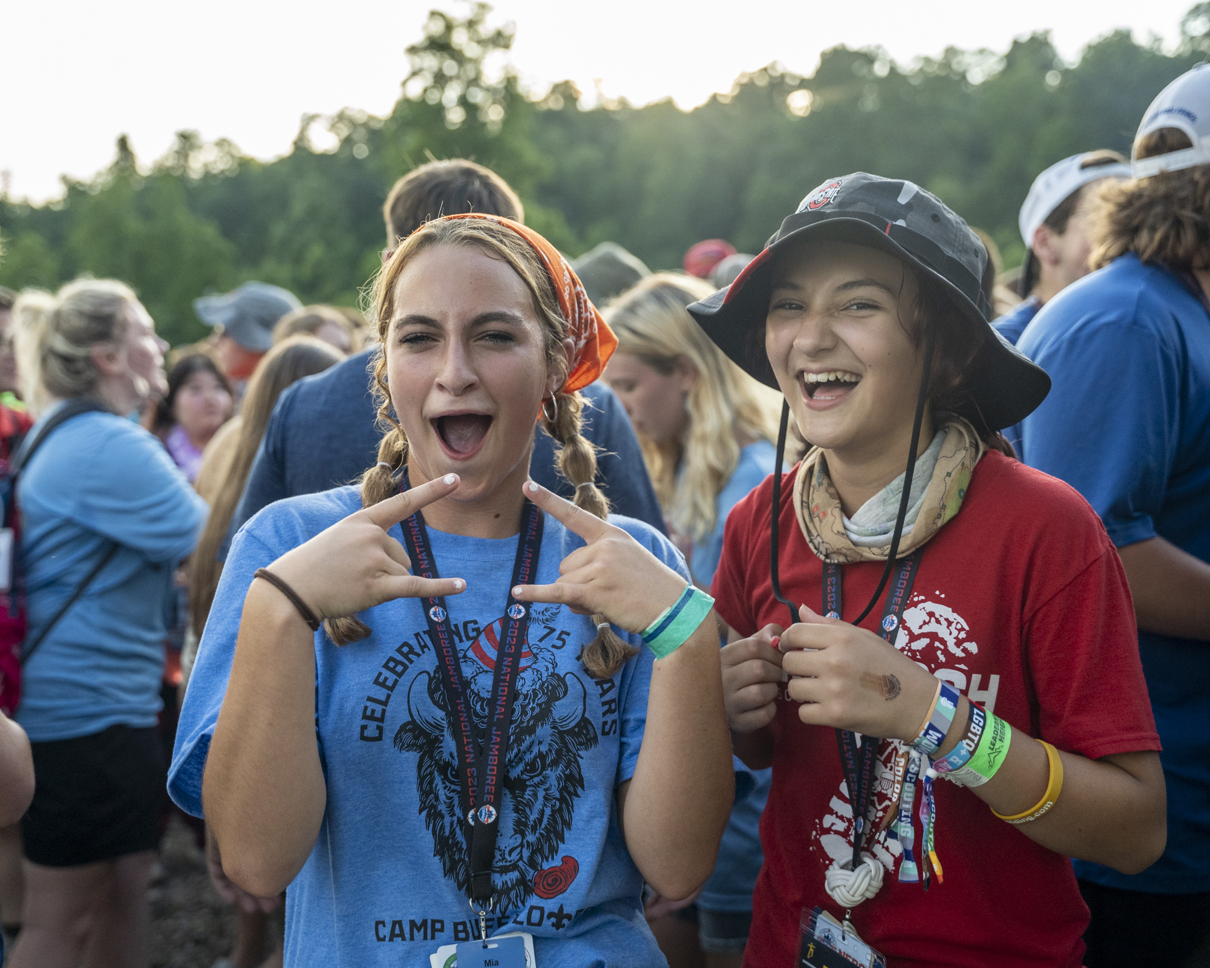

Welcome!
Mission/Vision
Notes:
For the purposes of today’s meeting, we unfortunately don’t have time for introductions with a group this size, please put your name and your title (if assigned/known) into your Teams settings.
Joe Introduction
Benicia CA
Emergency Physician, TPMG, Admin roles for HIT, HIM.
Many hats nationally and locally for Scouting America
Invested in welcoming, belonging, health, and well-being of all members
Mission
The mission of the 2026 National Jamboree Health and Wellness Pillar is to "Elevate Health and Elevate Well-Being" by fostering a warm, fun, and supportive clinic atmosphere where every Jamboree attendee feels safe and cared for. We integrate wellness and mental health services to enhance total health, utilizing our team's expertise and technology to optimize clinic efficiency. Our innovative programming promotes online safety, resilience and healthy habits to help manage life stressors effectively.
Vision
We provide holistic care in our medical clinics and effectively deliver wellness programming in a supportive environment, aligned with the core values and spirit of Scouting.
Let’s get into the agenda! Please save any questions until the open forum at the end, or you can place them in the chat. My HQ team will be scanning to see if we can answer them along the way.

Slide 3

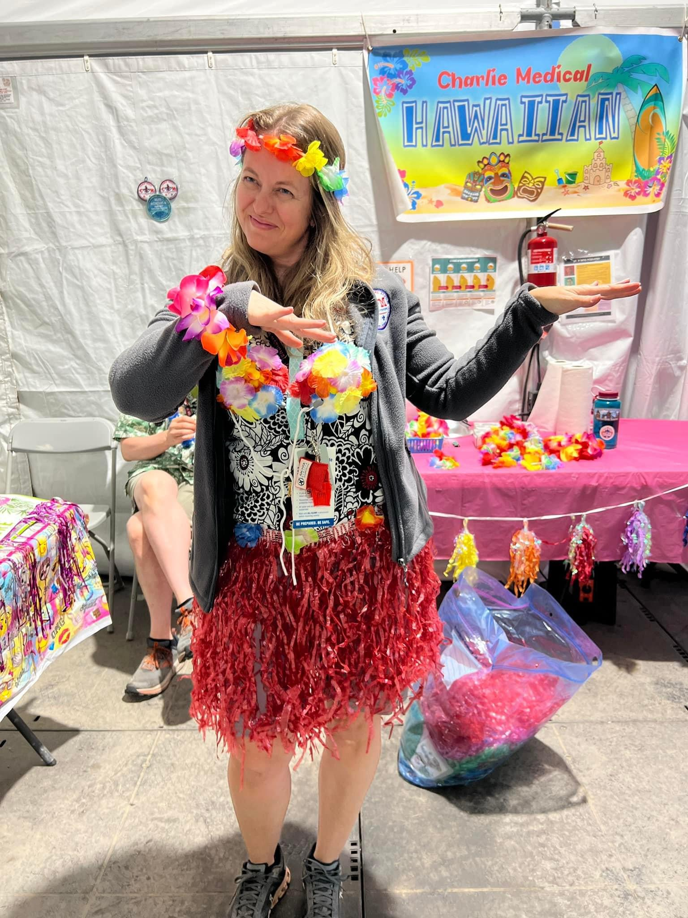


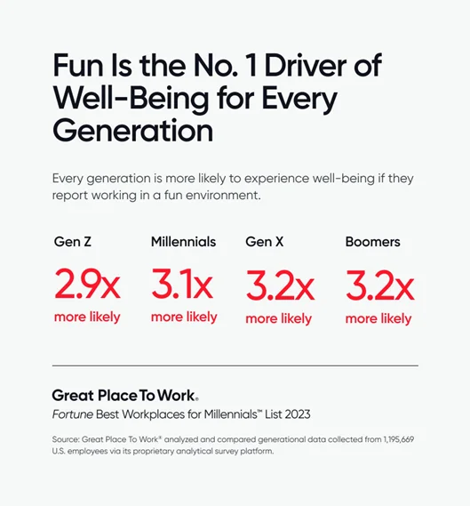
Pillar/Staff Culture
Notes:
This shouldn’t be work! Jamboree should be fun for staff, too! Fun Drives Well-Being.
The WSJ in 19 and the 2023 NJ have been the most fun I’ve had in Scouting.
Create a culture of positivity! Not forced fun – ORGANIZED fun.
Build a team!
Charlie Base Camp, Summit Center as example
Pre-Jamboree Get Togethers, Theme days, Staff Exercise, Snacks, Music, Post Jamboree Get Togethers
White Water Rafting
Swag/Branding
Logos and Jamboree Brand guide added to G drive
Plan for better quality swag – neckers, scrubs, polos, performance gear
Feel free to make clinic swag, but please stay on brand and avoid using the Jamboree TM logo
Education
Medical Explorers and Students – create a welcoming experience, challenge their skill set… shadowing, daily education time, etc
Self Care/Education for Scouts – please do NOT turn away Scouts. It’s not that much of a strain on inventory. Create an opportunity to teach them why their first aid kit is important and ensure they know how to care for simple concerns (note: we will be providing better training for the unit health & wellness leader in 2026)
CME – to be offered via WVU, lead has been identified. Plan for “roving” CME, with schedule TBD for base camp clinics, program clinics, medical HQ. Plan for food and snacks at HQ for evening CME sessions, when applicable. More info soon.

Slide 4
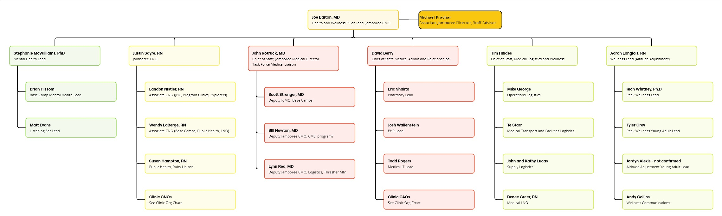
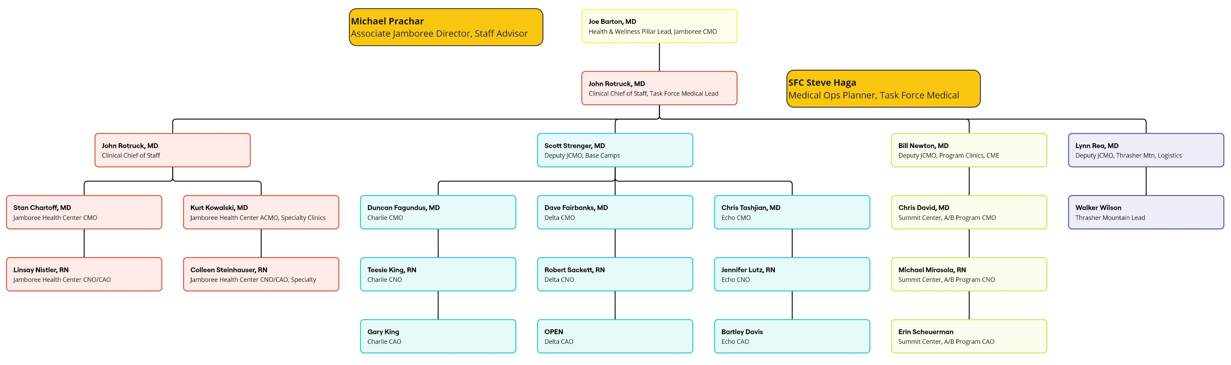
The Team
Notes:
Joe: I am thrilled with the outpouring of interest for staffing the 2026 event. We have 246 interested leads captured in the HubSpot CRM I’m using for communications. (Note: please ignore any other emails from Golden Gate Area Council – we have a lot of volunteers using HubSpot and there have been occasional errors that include the Jamboree interest and leadership lists). Our leadership team is nearly full, but we do have a need for a CAO for Delta Base Camp. In the weeks to come, we will begin to flesh out the staff under the medical HQ leads, in addition to identifying additional key staff for Elevate Your Well-Being.
My key team at HQ includes John Rotruck, Clinical Chief of Staff/Jamboree Medical Director/TFM liaison; Justin Sayre, Chief Nursing Officer; Stephanie McWilliams, Mental Health Lead; David Berry, Admin CoS for Medical Administration and Relationships; Tim Hindes, Admin CoS for Medical Operations and Wellness; and Aaron Langlois, Elevate Your Well-Being Lead. The org charts are available on the Health & Wellness Staff Site and will be updated and expanded as needed. For HQ staff, my goal is to set clear roles and responsibilities, but to avoid silos and to encourage cross communication wherever appropriate.
One thing that has become clear to me during recruitment is that each of you have many talents, and we may not have taken advantage of those to their fullest potential at previous Jamborees. Please, if you have an interest in addition to the role that you have already filled, don’t hesitate to reach out to me so that we can properly exploit it!
We will expand internal and external relationships to support the team. I’m excited to have John Rotruck on the team. Besides being my friend for the last 30 years and one of my mentors as I was applying to medical school, John recently retired from a distinguished career in the Navy as a Captain. We are going to pursue an improved relationship with Task Force Medical to support with personnel and material resources.
WVU has been a major supporter of our efforts and will continue to do so. We have discussed an expanded partnership and more opportunities for students as well.
Kristen Garcia, Scouting America National Director of Corporate Engagement and Strategic Partnerships is committed to expanding sponsorship opportunities. If you have any plans for donations of supplies, please make sure I am looped in to ensure we recognize that appropriately.
Finally, I’m also excited to have David Berry back in HQ. David is the chair of the National Safe Scouting Committee and we are aligned in an effort to better partner with our various workstreams in Scouting that support Health and Wellness, in addition to obtaining and analyzing better data at the Jamboree.

Slide 5
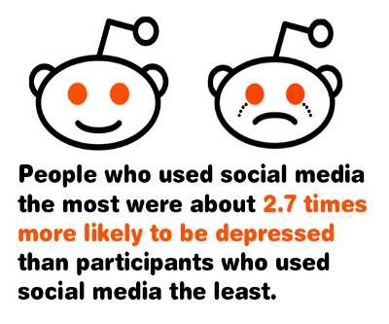
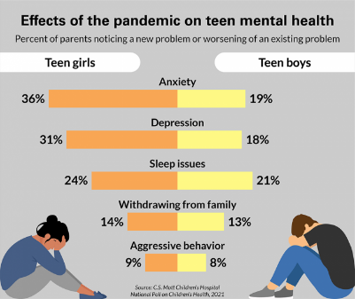
Notes:
You know, growing up today is pretty complicated for young people. I’ve got two awesome kids, Andrew, who’s 12, and Olivia, who’s 10. Andy’s a 2nd class Scout, plays the euphonium, and is a star winger on his soccer team. Olivia’s a performer; she’s been involved with the SF Opera and even has been an actress in some YouTube projects. They’re both super busy with activities, which is great because otherwise, they’d be stuck to their screens all day. They bring so much joy into my life. They’ve grown up in this digital age and went through the COVID pandemic while still in elementary school.
Growing up in a two physician household, their worries about COVID were pretty intense, especially since we were working in high-risk environments during the early days of the pandemic. We’ve really focused on their wellness and emotional intelligence. We’re lucky to have the resources to support them, but I know not every family has the ability to provide the same.
Research shows that COVID and screen time, especially with social media, can have negative effects on young people’s mental health. Young adults on social media are more prone to depression and even higher suicide risks. Since 2000, suicide rates have jumped 87% for females aged 15-24 and 30% for males. Studies using fMRI have shown that teen brains aged about three years in just ten months during the pandemic, similar to trauma responses.
Scouting America is in a great spot to teach young people about emotional intelligence and online safety, just like learning to build a fire or use a knife safely. Scouting’s had its challenges, but it’s time to remind everyone why we’re the top choice for youth development.
Personally, without Scouting, and especially the Order of the Arrow, I wouldn’t be where I am today. My medical school interviews focused more on my leadership experiences with the Order of the Arrow than anything else. Many of you have heard about Elevate Your Well-Being. It’s my passion project, partly for kids like Andrew and Olivia, and partly because I’m a survivor of abuse in Scouting and in my home. Growing up in McKeesport, PA, a struggling steel town, I joined Scouting at 11. My first troop was tough; I faced degrading bullying from older scouts. After that troop dissolved, I joined another, but faced grooming and abuse from an Assistant Scoutmaster, who was also a priest at my church. That troop also dissolved, and he was eventually defrocked. I was a Life Scout then, needing to finish my Eagle project.
I graduated high school early and started college at 16, working nearly full-time to support myself. I joined a third troop because I could drive to meetings. At that time, Family Life became a required merit badge. While working on it, the merit badge counselor would hold sessions in a windowless, large storage closet in the troop meeting room... for "privacy." I felt incredibly uncomfortable with the setting and the conversations that occurred in that room, so I stopped attending meetings. I stayed registered in Scouting because I was elected lodge chief and later served as a national OA youth officer in 1997. I am hopeful to be one of the first to apply for the alternate path to Eagle that is near approval.
It took a long time to find the courage to seek therapy and process that trauma. I’m sharing this with you because it’s therapeutic for me and gives context to the wellness work I want us to pursue. Instead of becoming a claimant, I’m advocating for wellness and belonging throughout the organization.
I believe Scouting is a safe place for young people to grow and learn. I shared my story because I believe in the work that we all do to support health and wellness, and it's time to show Scouting America how we can help organization wide. Elevate Your Well-Being. It’s going to be transformative, teaching young people essential life skills for online safety, to handle tough emotions, and to recognize when peers need support. It’ll be a new value proposition for parents considering programs for their kids and will make Scouting America even safer for all young people.
Our program will include integrated mental health and wellness spaces at our clinics at Altitude Adjustment areas, offering digital detox, hydration, cooling, and collaborative face-to-face activities combined passive wellness learning. Peak Wellness will showcase innovative and interactive ways to experience and learn well-being.
I encourage you all to check out the executive summary on the Health & Wellness staff site. Our core leadership team is welcome to join the planning. We’re partnering with West Virginia University, the US Department of Homeland Security, and many Scouting America committees. Elevate Your Well-Being will be part of the Jamboree report to the National Executive Board. Everyone I’ve talked to is supportive, and we’re seeking major sponsors to support rank advancement and merit badge requirements. Our partners and the EYWB team will ensure all proposals and activities are age-appropriate and science-based.
A further goal is to align Scouting America efforts around MESH standards, adult mental health first aid training, and peer-to-peer training and awareness. I am committed to achieving this vision, which will extend beyond the Jamboree.
Our wellness leads will pair with young adult leads to help plan and deliver this program. In your recruitment for the Jamboree, please promote this program in addition to medical and mental health services.
As we move forward with the Elevate Your Well-Being initiative, I encourage each of you to take time to focus on your own wellness journey. Between now and the Jamboree, let's commit to prioritizing our mental and emotional health, just as we aim to do for the young people we serve. Whether it's through mindfulness practices, physical activity, or simply taking a moment to breathe and reflect, every step we take towards our own well-being strengthens our ability to support others. Together, we can create a culture of wellness and belonging that resonates throughout Scouting America. Let's lead by example and make a positive impact, starting with ourselves.

Slide 6
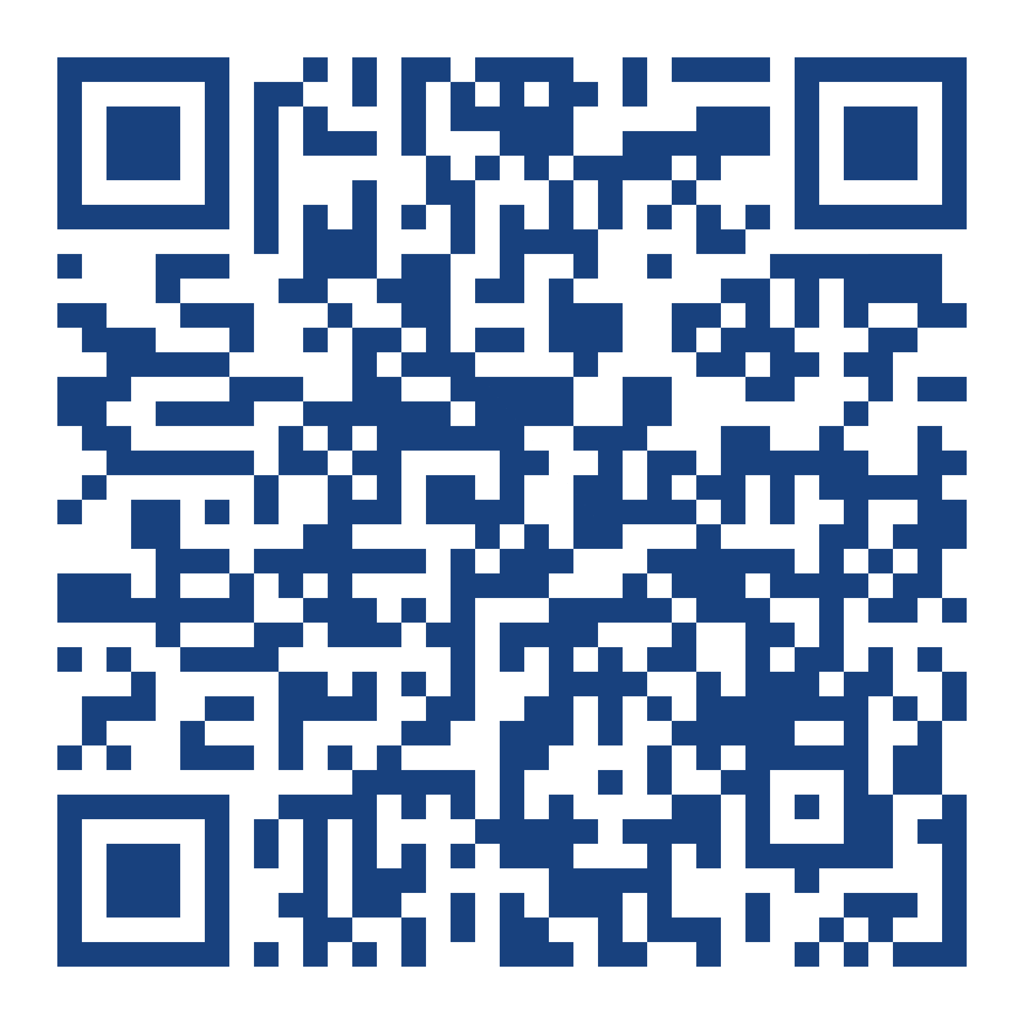
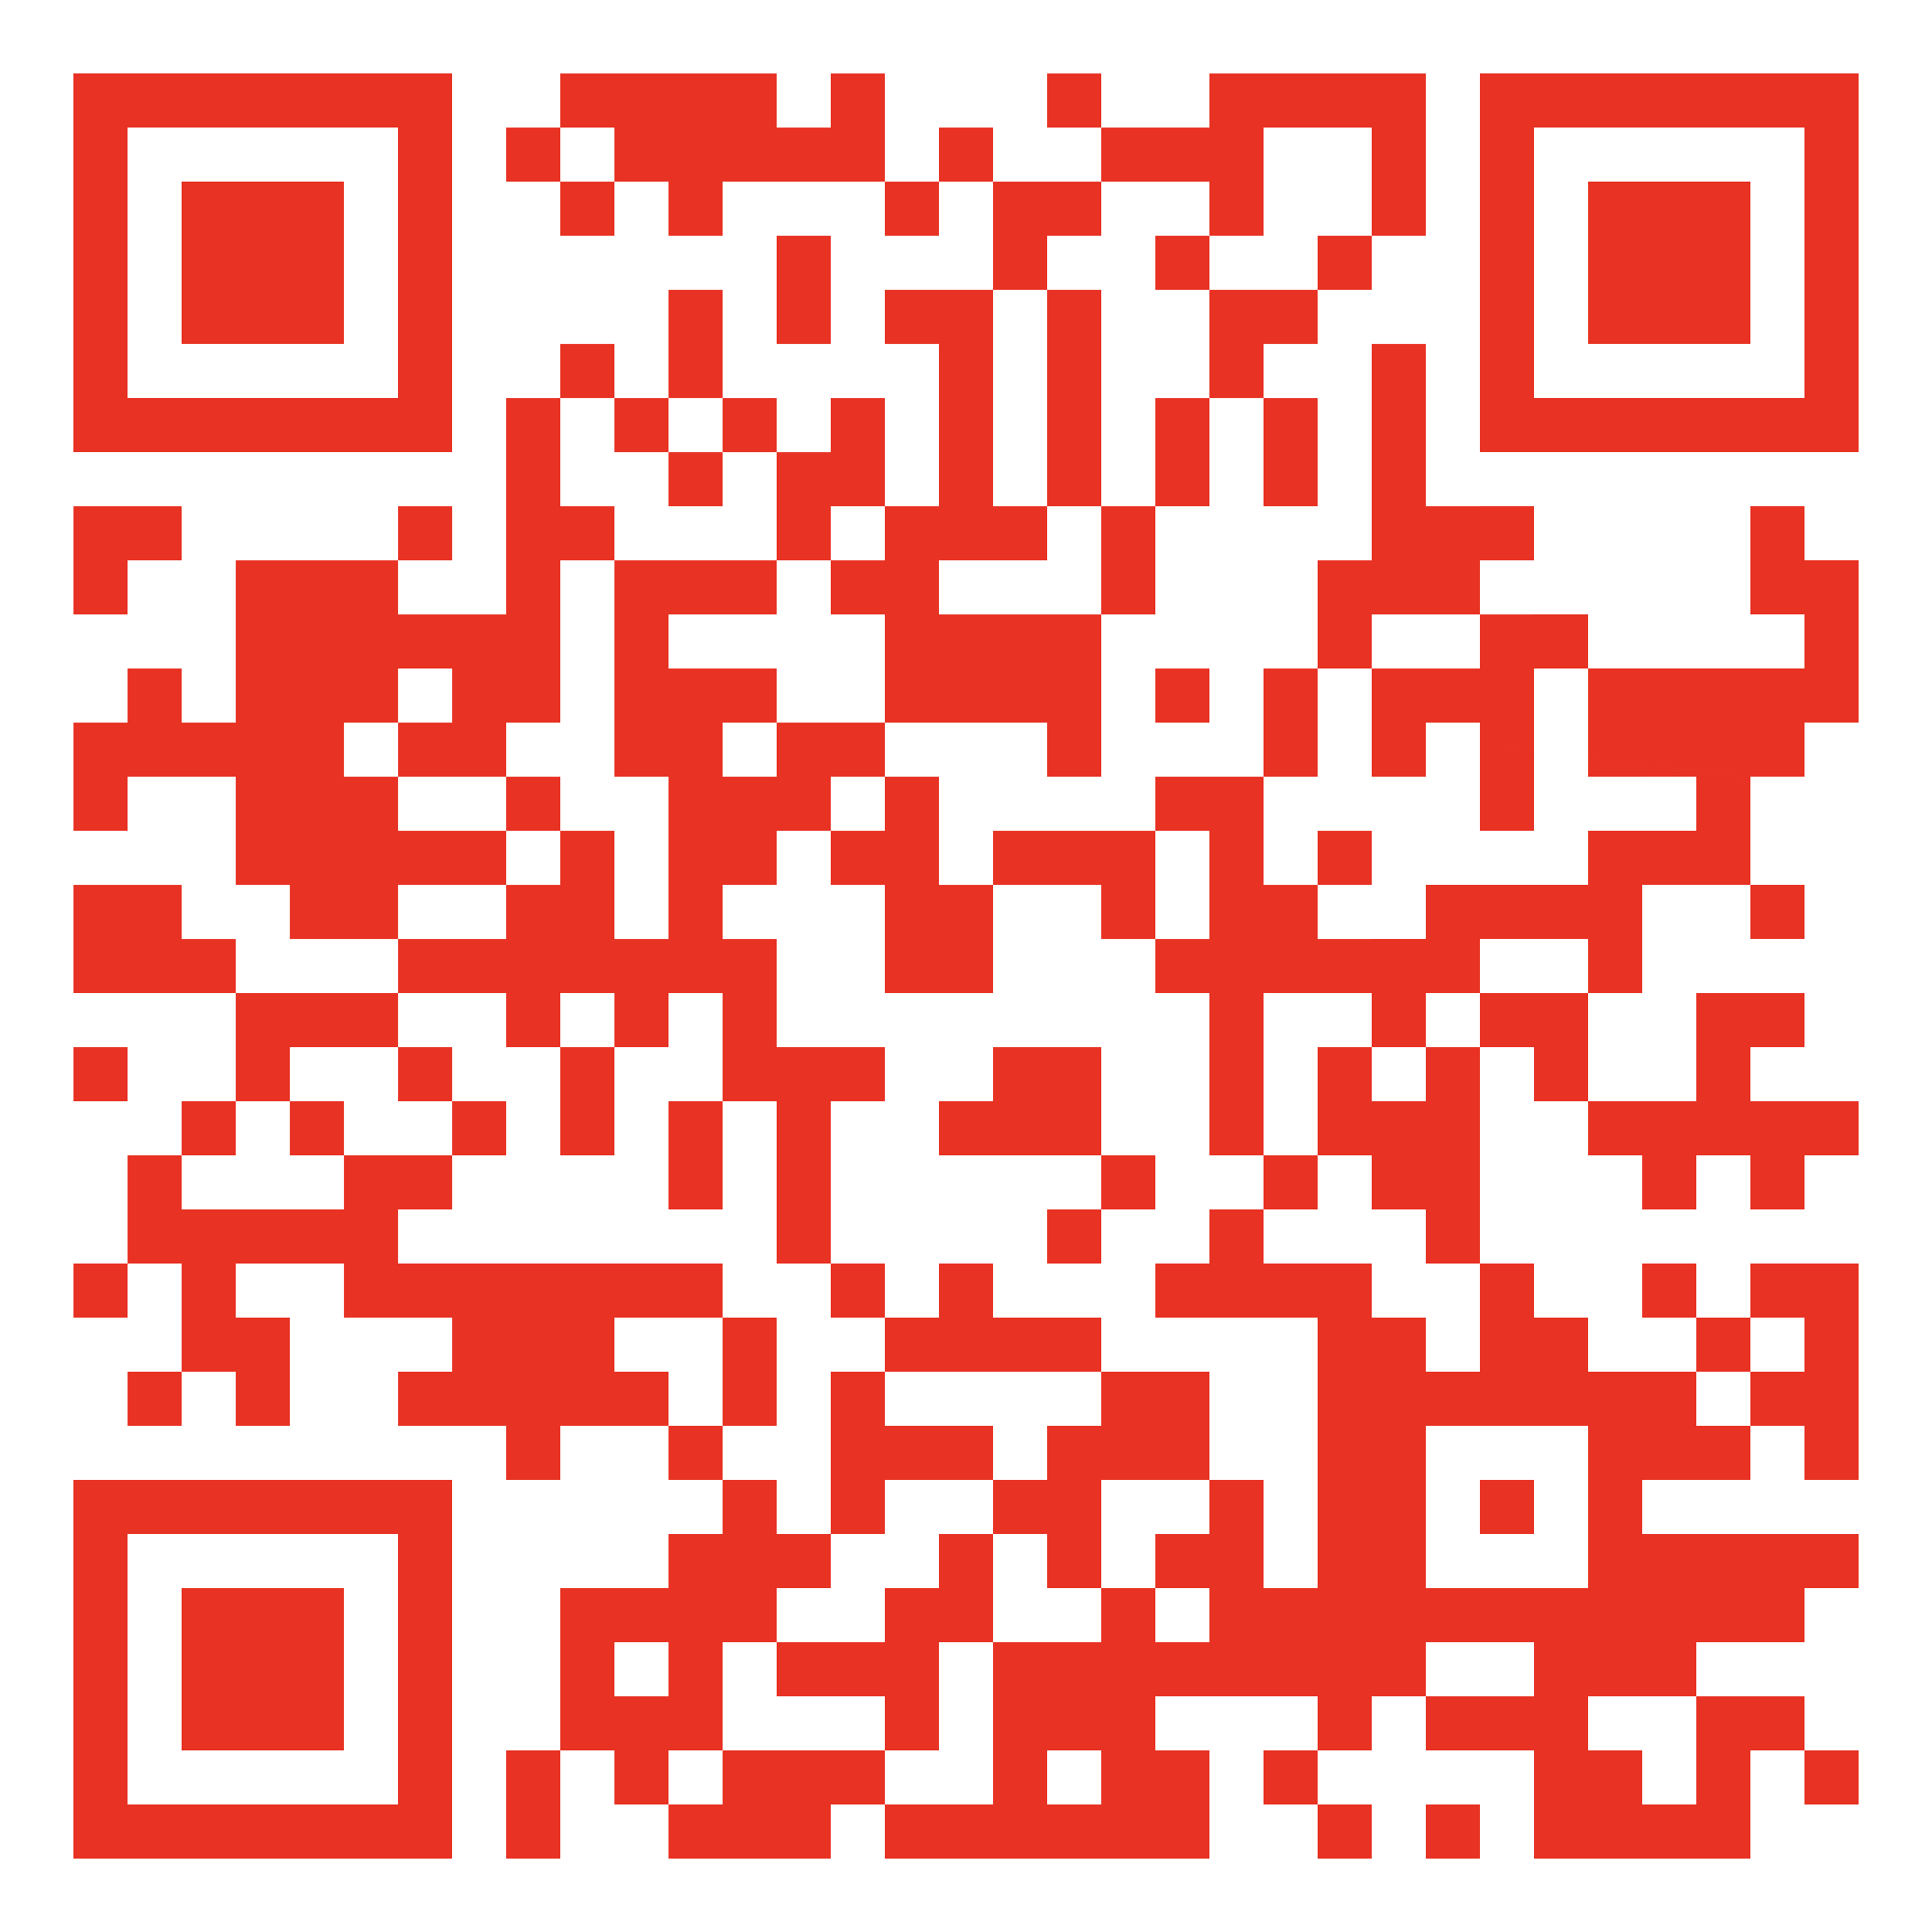
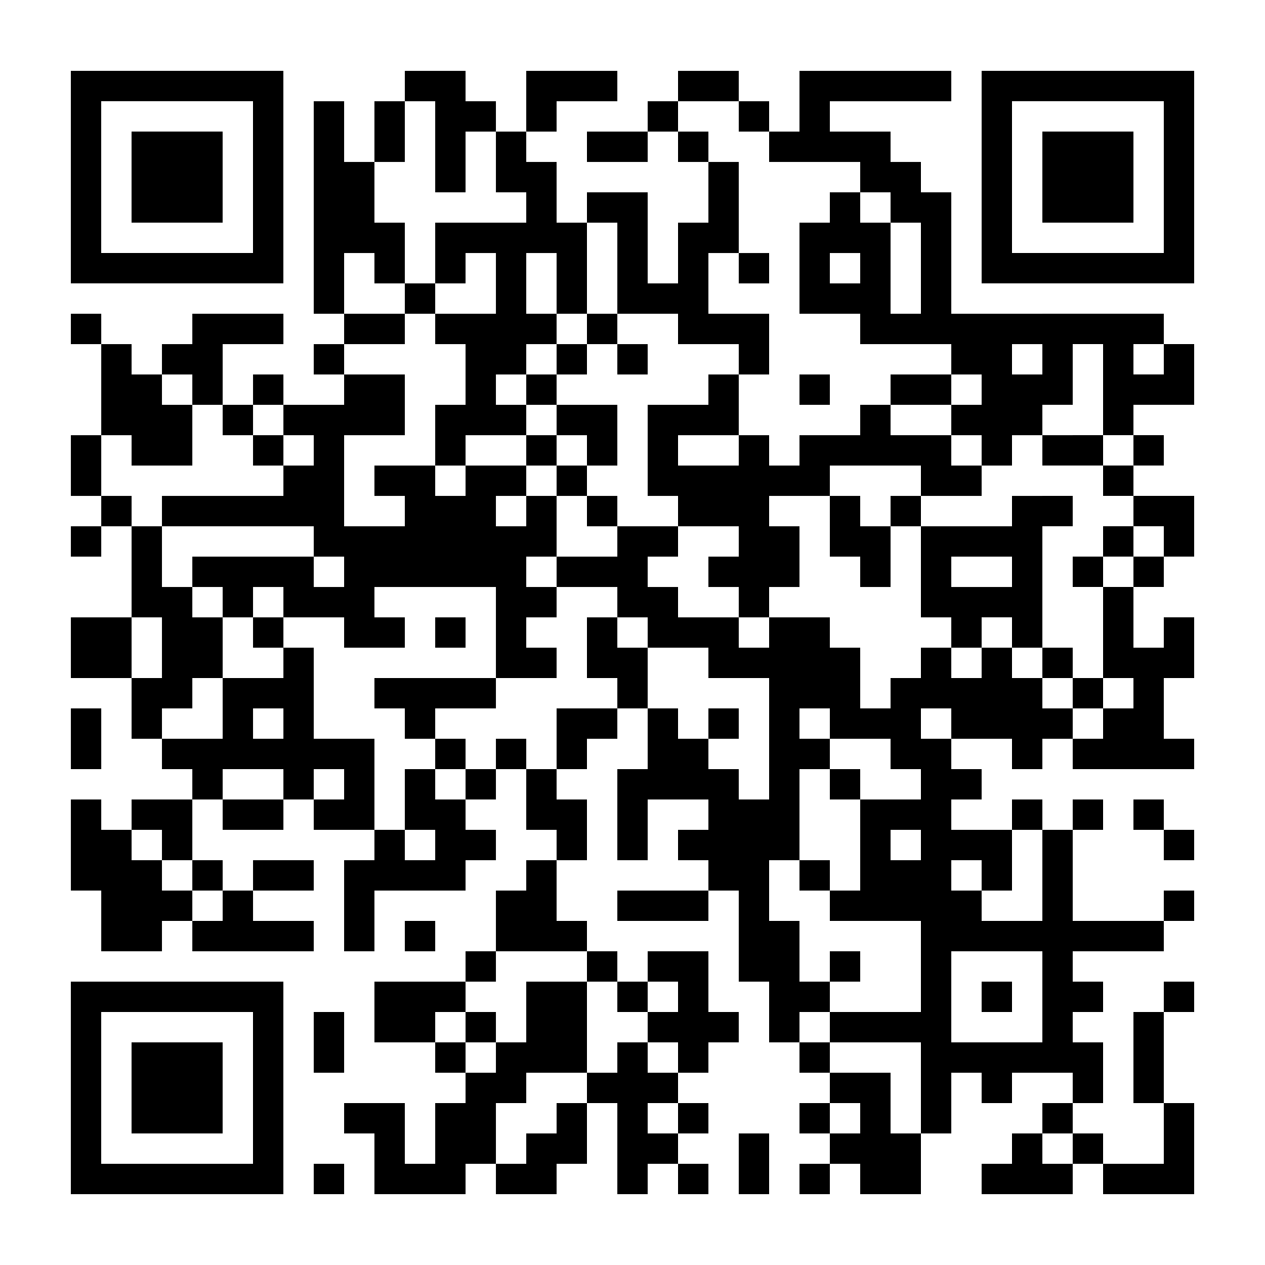
Communications
Google Group
Google Chat
Staff Website
Notes:
I’ve been a medical staff member since 2013. I am of the firm belief that you cannot overcommunicate. It’s been top of mind for me to improve our communication, for the lead up to the event as well as onsite. We are going to first discuss the tools I am using for lead up – Google Groups and Hubspot. Note the QR codes and hyperlinks. I will send out slides and plan to add the google links to the staff site.
Many of the core leadership team have joined the google group and many of those that joined have found their way to the google group. The google group is open to the public for now but will likely be changed to private invite in another month or two once the complete team is identified and onboarded. If you haven’t joined the group, this QR code will allow you to do so. If you’ve already been invited to the google chat, that QR code would allow you to finish joining the chat. If you have not yet been invited to the chat, that link will also allow you to request access to the chat – provided that you have joined the group. Hopefully this step will solve the issue that’s been faced with joining the group. You may need to link a non gmail account to google in order to join, in some cases. This will be prompted once you try to join.
Also, please be sure to turn on notification settings. I want to use our meeting time efficiently, and if we can have conversations on the google chat, it will allow for a more streamlined agenda in meetings to come. Because of the meeting cadence through summer of ‘25, this will also allow for communication and problem solving between meetings. The google group does have an attached g drive for our file storage in lieu of Dropbox. It will have more reliable, current info by Q2 2025.
The bottom QR code links to the staff website. This will be a continual work in progress. It currently includes the interest link for the HubSpot mailing list, a budding content library, org charts, and my previous emails. The plan is to add items such as treatment guides and other admin updates. We can also add a clinic page.
Please do not create other pages for your clinics, the Jamboree Admin team and the national office are asking that all pages be directed through jamboree.scouting.org. I have permission from the Executive Committee to have a staff website as proof of concept for future events and for continued use of a platform like HubSpot, but JST wide. Any clinics wanting to manage a linked page to the site will need to learn HubSpot, but it’s a simple point and click interface and is a breeze to learn.

Slide 7
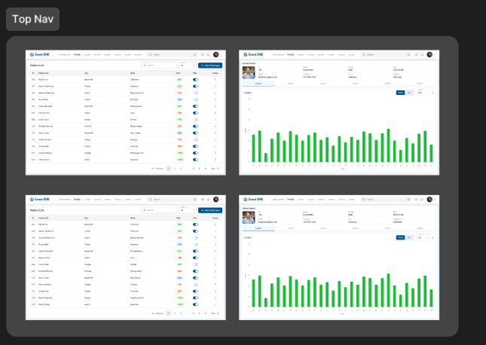

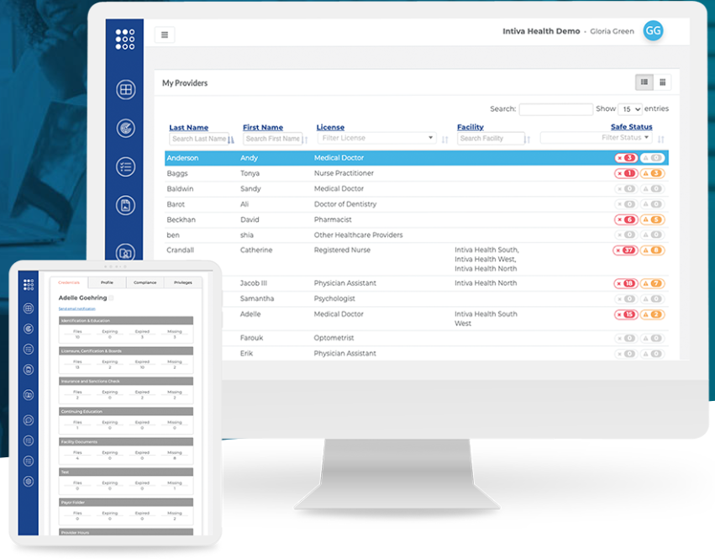

EHR/Credentialing
Notes:
The Cerner EHR has been a source of frustration for many staff members at recent Jamborees, despite a great partnership with their company. Ideally, an EHR should improve coordination of care, provide an easy interface for documentation, be a reliable source of data, and allow for resource optimization. Finding a better solution was also a priority for me for 2026. The data set from 2023 demonstrated that Cerner isn’t the answer to our needs – there were many incomplete encounters compromising data accuracy… though arrival patterns to the clinics is one analysis that may be helpful in our planning. The g drive will soon contain the data dashboard from 2023.
As you know, we’ve had a lot of paper processes and the files were stored digitally, but sometimes in a variety of different places. Communications between facilities and with medical HQ for important functions like opening/closing procedures, deliveries, nonurgent transport, and one call have been done by phone with paper reporting.
I was shocked to hear that we didn’t do a full inventory out of our supplies in 2023 because many consumable supplies were just returned to WVU. We can and should do better. I’ve invested a lot of time in the early planning phase to identify a company that could create a custom solution for us. I’m pleased to report that we are nearly through the discovery phase with Thinkitive. The Event EHR is a comprehensive app that Scouting America will own for future use, at less than ½ of the cost of one Cerner contract for Jamboree support. It will improve patient flow along with internal and external communication.
This software will be user-friendly and template based. It is designed for device use from phones to tablets to laptops. This will decrease our IT footprint and need for printing as well. Automated processes for notifications to base camp and Jamboree HQ, scheduled notifications for emergency contacts with secure messaging, and transfer processes to our partnering hospitals will provide better coordination and notification of care. Task functionality and chat will allow us to make many paper processes and requests online. Inventory functionality will allow for better tracking of supply use and allow for automated PAR reorder level requests, among other bells and whistles.
I have identified an EHR lead, Josh Wallenstein, who will be taking over for the testing and training portion of the build. I expect this to occur in the coming months. Training will be a much lighter lift than we have experienced for Cerner. We will add information to the staff site content library as the build continues and testing will occur in summer 2025 at the summit via Bryan Wilson and his team.
I have secured a contract with ReadyDoc to help offset the tremendous amount of work we all put into credentialing our team for a summit health services permit. ReadyDoc allows you as the user to upload credential documents to the Ready Doc™ platform. It allows for the leadership team to review documents without having to match file names to a person. This means spending less time on credentialing. In addition, the platform auto verifies credentials and monitors databanks for alerts for expiring credentials or credentials facing any sanctions. We will also test this platform at the Summit in 2025 and I do not expect any training on the platform to occur until late 2025. At the present time, the full credentialing service with auto verification is not available for all of the types of providers we have for Jamboree, but the company is making us a use case to implement for all of our provider types. Even if that doesn’t happen to the full extent, the user upload and some of the features are available for all. As with the EHR, content will be uploaded to the content library as I learn more.

Slide 8
Meetings
2nd Monday 5 pm pacific
      All are welcome, but HQ staff should attend all
  Wellness – even months
  Medical – odd months
  Cadence may change post NAM
No plans for in person medical
Plan for EYWB meeting at NAM
    Orlando, May 12-16, 2025

Slide 9
Meetings
Standard agenda
  Welcome/Intro
  Updates
  Old Business
  New Business
  Housekeeping
  Items for Next Meeting
  Open Forum
  Close

Slide 10
Next Steps
Recruit! Recruit! Recruit!
Staff site/interest form
Reg opening (fall/winter TBD)
Jambo ExCom 1st weekend Nov
  Update to follow
Further updates as needed

Slide 11
Open Questions

Slide 12




Notes:
TP

