Slide 1

National Jamboree 2026
What You and Your Council Need to Know
Dr Glenn Ault – Jamboree Chair
Tom Pendleton – Jamboree Director
Notes:
Glenn – welcome everyone
Partnership with the professional staff and volunteers.

Slide 2
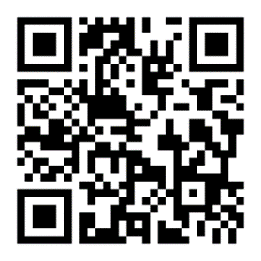

Safety Moment
Notes:
TP
SUMMARY
Scouts and their parents expect all Boy Scouts of America activities to be conducted safely. To ensure the safety of participants, the Boy Scouts of America expects leaders to use the four points of SAFE when delivering the Scouting program. Included below are examples of real incidents in Scouting where at least one of these four points was not followed. Please do not put participants at risk by ignoring these principles.
GENERAL INFORMATION
S = Supervision
Youth are supervised by qualified and trustworthy adults who set the example for safety.
Three youth went on a backcountry trek without adult supervision. One teenage Scout died of heatstroke.
A 12-year-old Scout was alone in a dug-out sand dune that collapsed on him. He died later that day.
Scouting policies like two-deep leadership and the buddy system safeguard against tragedies like these.
A = Assessment
Activities are assessed for risks during planning. Leaders have reviewed applicable program guidance or standards and have verified the activity is not prohibited. Risk avoidance or mitigation is incorporated into the activity.
Two Scouts were burned while lighting a homemade stove. They had made the stove out of a soda can and were trying to fuel it with HEET®, a liquid fuel additive. The use of homemade stoves is prohibited.
A Webelos Scout slipped and fell 25 feet into a ravine while hiking with older Scouts who were exploring an unpaved trail. The boy hit his head on rocks and suffered severe brain trauma. He was airlifted to a local hospital and never regained consciousness.
Understanding and following the guidelines contained in program materials and the Guide to Safe Scouting helps keep all youth safer in our programs.
F = Fitness and Skill
Participants’ Annual Health and Medical Records are reviewed, and leaders have confirmed that prerequisite fitness and skill levels exist for participants to take part safely.
An 18-year-old assistant Scoutmaster, who had recently tested as a beginner swimmer during summer camp, drowned while attempting to swim across a river with two younger Scouts on a unit outing.
A 38-year-old Webelos parent suffered a fatal heart attack during an overnight backpacking trip with his son’s den. The parent had been denied participation in a similar hiking activity due to poor physical condition and a body mass index greater than 40.
Fitness is an aim of Scouting. Knowing who can and should participate in a particular activity — by having the necessary fitness and skill to do so — keeps youth and adults SAFE.
E = Equipment and Environment
Safe and appropriately sized equipment, courses, camps, campsites, trails, or playing fields are used properly. Leaders periodically check gear use and the environment for changing conditions that could affect safety.
A 13-year-old Scout fell about 20 feet from a zip line at a commercial rock gym facility and landed on his feet, injuring his left foot. Witnesses say the youth was seen using the zip line without properly fastening the restraining carabiner.
Three Scouts were sitting on a picnic table under a metal carport during a severe thunderstorm when they were struck by lightning. A safe building during a storm is one that is fully enclosed with a roof, walls, floor, plumbing, and wiring.
“Be Prepared” is not just a motto but a method to follow to be safe. Using the right equipment for the right activity and in the proper location keeps Scouting SAFE.
RESOURCES
SAFE
Safety Moments

Slide 3
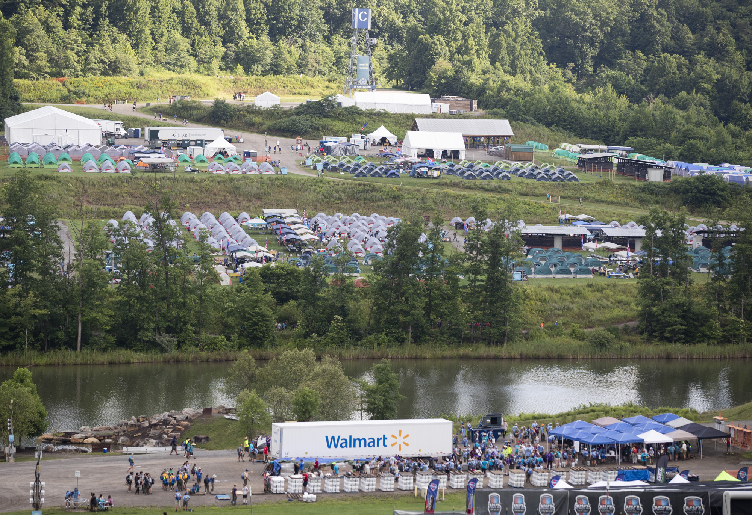

2026 National Jamboree
July 22-31, 2026
Summit Bechtel Reserve
Notes:
Glenn
Invite them to be a part of the JST
JST registration will go out this fall.
Blue Border is JST
Red border is the participant

Slide 4
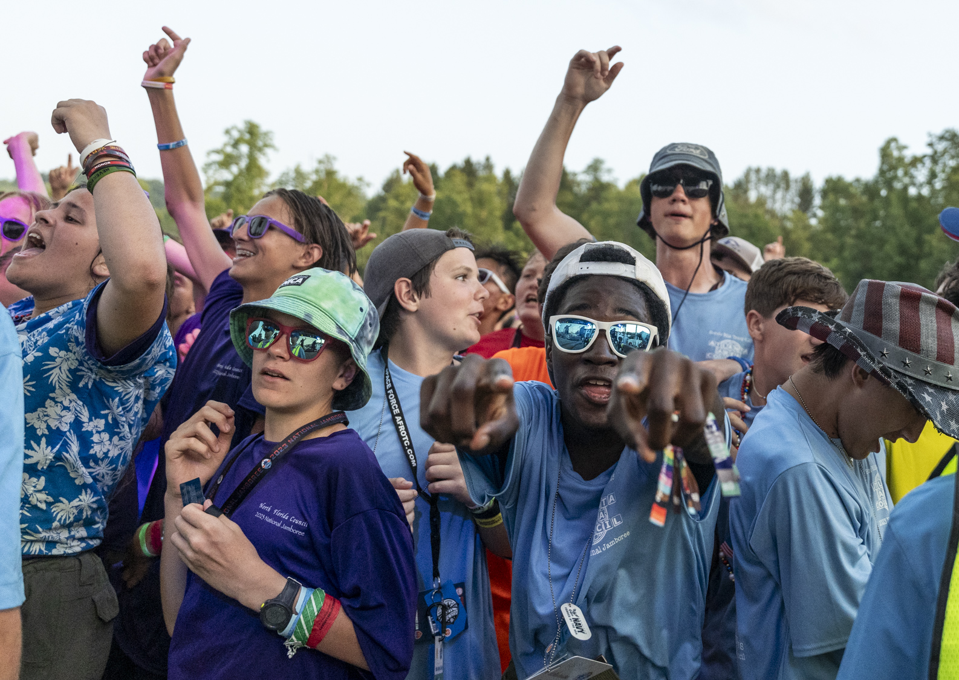
Your Leadership Team
Chair – Dr Glenn Ault
Contingent Operations – Gary Crum
Program – Andrew Miller
Logistics – Reid Christopherson
Administration – Ryan King
Emergency Management – Dr. Bryan Wilson
Health and Wellness – Dr. Joe Barton
Finance/Safeguarding – Bob Noble
Belonging and inclusion – Cathie Seebauer
Jamboree Director – Tom Pendleton
Notes:
Glenn
Intro any of them in the room
This team has been assembled to put together a great Jamboree experience, but we need your help.

Slide 5
Territory contacts for SE
NST 1 – Lynn Gunter
NST 3 – Mike Hale
NST 4 – Tim Molepske
NST 5 –
NST 6 – Jeff Whitten
NST 7 – Michael Jenkins
NST 8 – Nathan Baie
NST 9 – Don Shepard
NST 10 – Richard Stockton
NST 12 – Scott Hanson
NST 13 – Davis Fox
NST 14 – David Williams & JT Dabbs
NST 15 – Jamie Parnell
NST 16 – Eric Magendantz & Terry Whitaker
Notes:
Tom
We will have some SE who will be our help through the planning and will also be able to help you when you need a hand
Don and David’s role

Slide 6
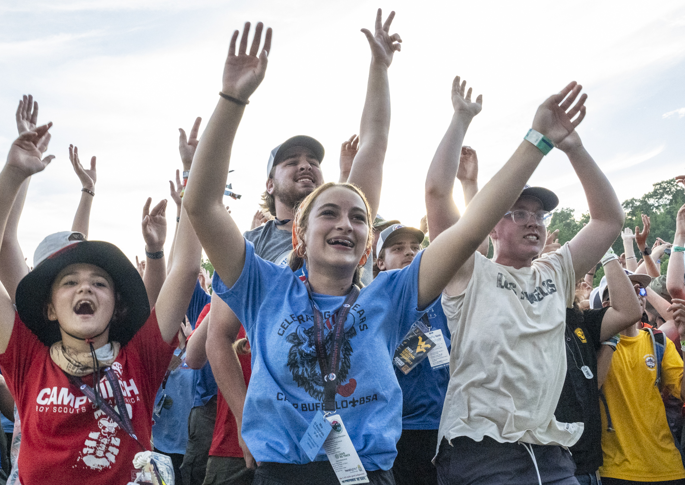
Why Jamboree?
The Jamboree program will prepare Scouts for a life of purpose and impact
Lifechanging experience for youth
Notes:
Glenn
Jamboree is a lifechanging experience
Jamboree is an opportunity for Scouts to see that Scouting is larger than just their community
Jamboree allows Scouts to connect with other youth from across the country and make lifelong friends

Slide 7

Jamboree Theme - ELEVATE
Elevate our Scouts and their experience
Design elements
  Mountains of WV and the New River
  Compass pointing us upward to new heights
  Contour lines show how we plan to ELEVATE the experience.
  Contour lines are from the Summit
  Scouting America Branding
  Colors for the 250th anniversary of the USA
Notes:
Glenn
We are working with the marketing team to get out the brand guidelines and some promotional assets for you to use in promotion
We will be working with Supply on the patch guidelines

Slide 8
Timeline
July 22-31, 2026, Jamboree dates!
Registration to open this fall – start now in recruiting participants and Jamboree Service Team members.
JST registration open this fall – Council will approve all JST and participants.
Payment schedule coming with registration.
Notes:
Glenn

Slide 9
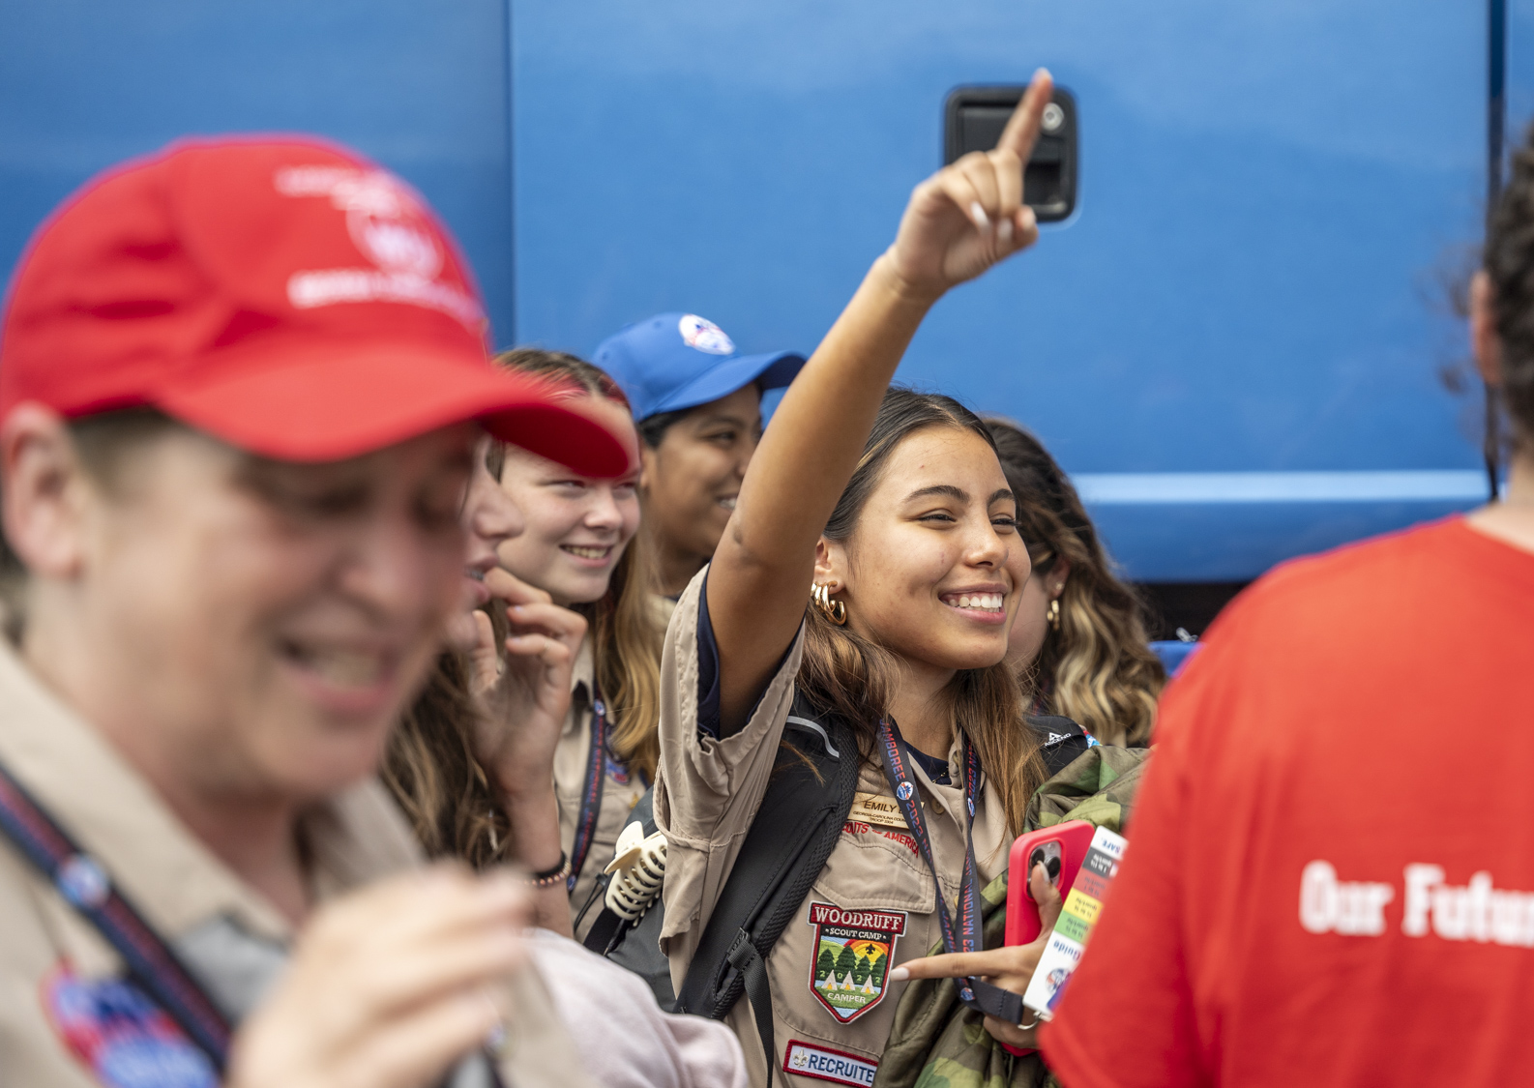
Administration - Registration
New system from 2023
Council registration – council contingents of 20 or 40
18 youth and 2 adults or 36 youth and 4 adults
You decide male troop, female troop, crew/ship make up – 6 choices to allow your council maximum flexibility
YOU control your units
Council combining – work with other councils in your territory to combine to fill spots
Visitors and VIP experiences
Notes:
TP
New system from 2023
Council registration – council contingents of 20 or 40
18 youth and 2 adults or 36 youth and 4 adults
You decide male troop, female troop, crew/ship make up – 6 choices to allow your council maximum flexibility
YOU control your units – you can dictate the size of your units if you do not fill a unit – council will be billed for a half or full troop no matter the people who attend. (i.e. your council can decide to only have units of 32 or 12 but will be billed for a half or full troop.
Council combining – work with other councils in your territory to combine to fill spots
Contingent guide will be out this summer
Visitors and VIP – more coming on the plan, so stay tuned, but yes we will have some VIP experiences

Slide 10
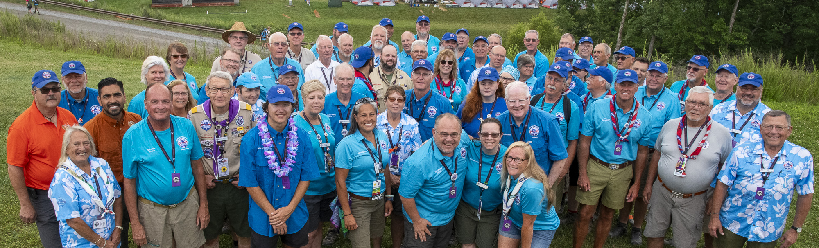
Contingent operations
Councils and JST will bring their own tents
Council units will be placed as close as possible to each other
Reach out to your territory contact for help in filling
Subcamps being used (C/D) for participants
Echo for staff
Notes:
Glenn
We are still working on the plan, but will work to place council units as close to one another as possible.
Our goal is to have your boy troop and your girl troop in the same subcamp as we know this was a concern in 2023.
This will be contingent on getting good commitments from the councils and filling those units.

Slide 11
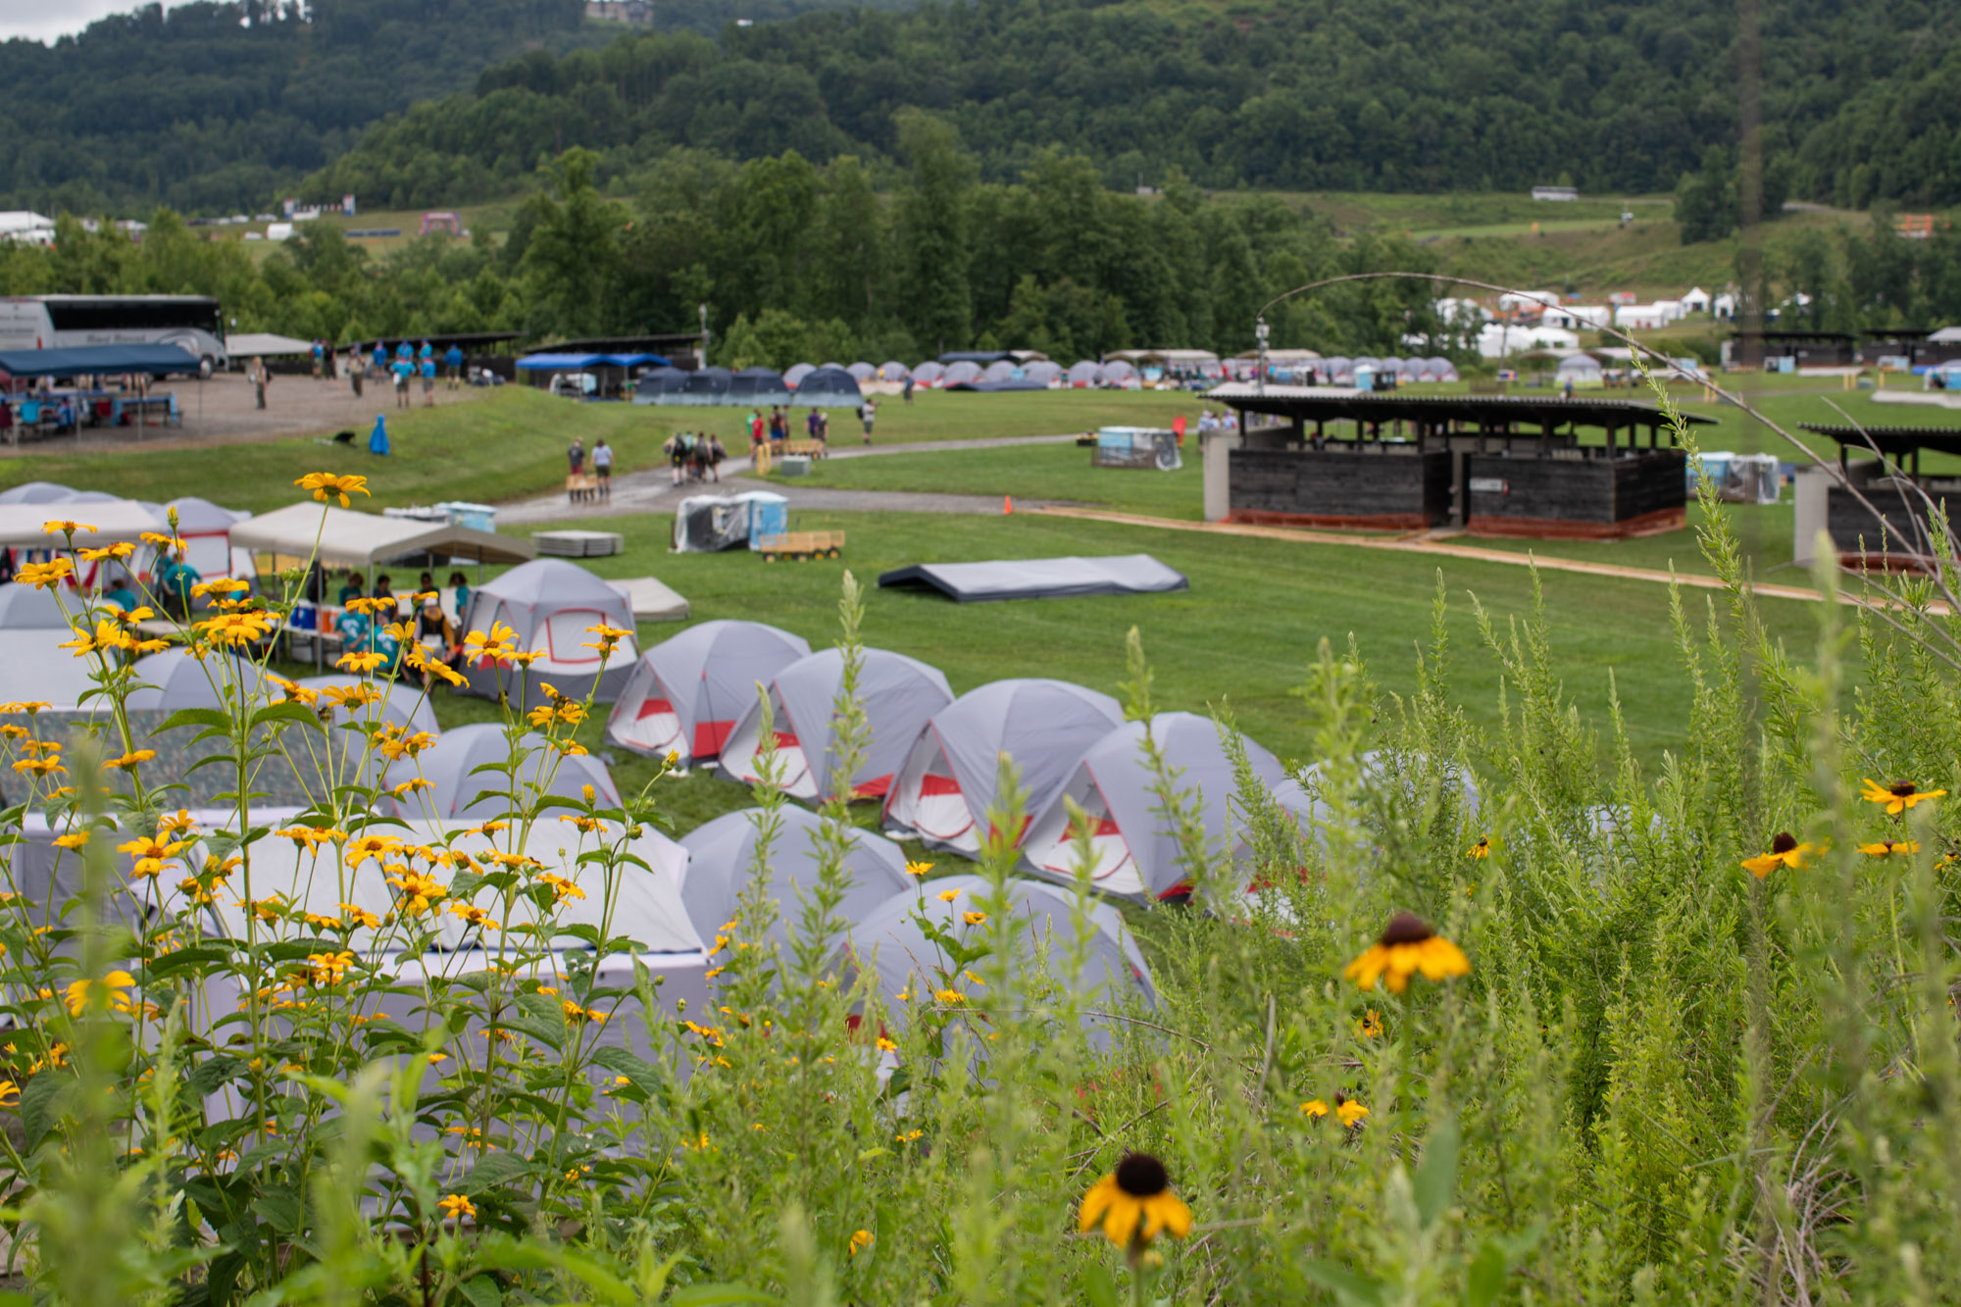
Logistics
Bus contact for preferred vendor
Food service will be commissary style with predetermined menu
Staff parking and staff vehicles will be allowed
Contingent parking and trailers will be allowed to park at Ruby Welcome center
Notes:
Glenn
We are working to have a preferred bussing vendor. The agreement with TMS expired at the end of 2023 so this will be bid out as well.
Food will be served for participants in the same method as in 2023 with a set menu and commissary distribution
Staff will be allowed to bring vehicles and we will work to allow staff access to their vehicle throughout the Jamboree
We anticipate many councils will again bring trailers with equipment. These trailers will once again be able to park and be stored at Ruby welcome center. No onsite trailer or contingent parking will be allowed.

Slide 12
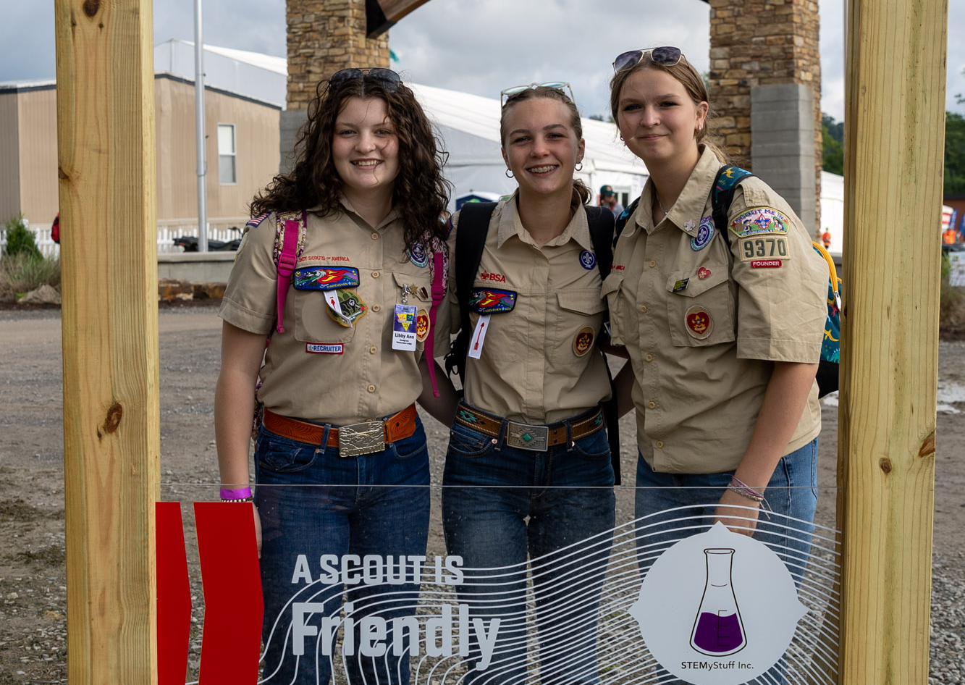
Health and Wellness
Prescreening for participation
Must meet the HA height and weight
New medical process for AHMR forms to be uploaded
Notes:
TP
We plan to have a new system for uploading AHMR forms
This will allow us the ability to prescreen, but we need your help to ensure you are not approving staff or participants who are not able to attend the Jamboree
This includes the HA height and weight restrictions.

Slide 13
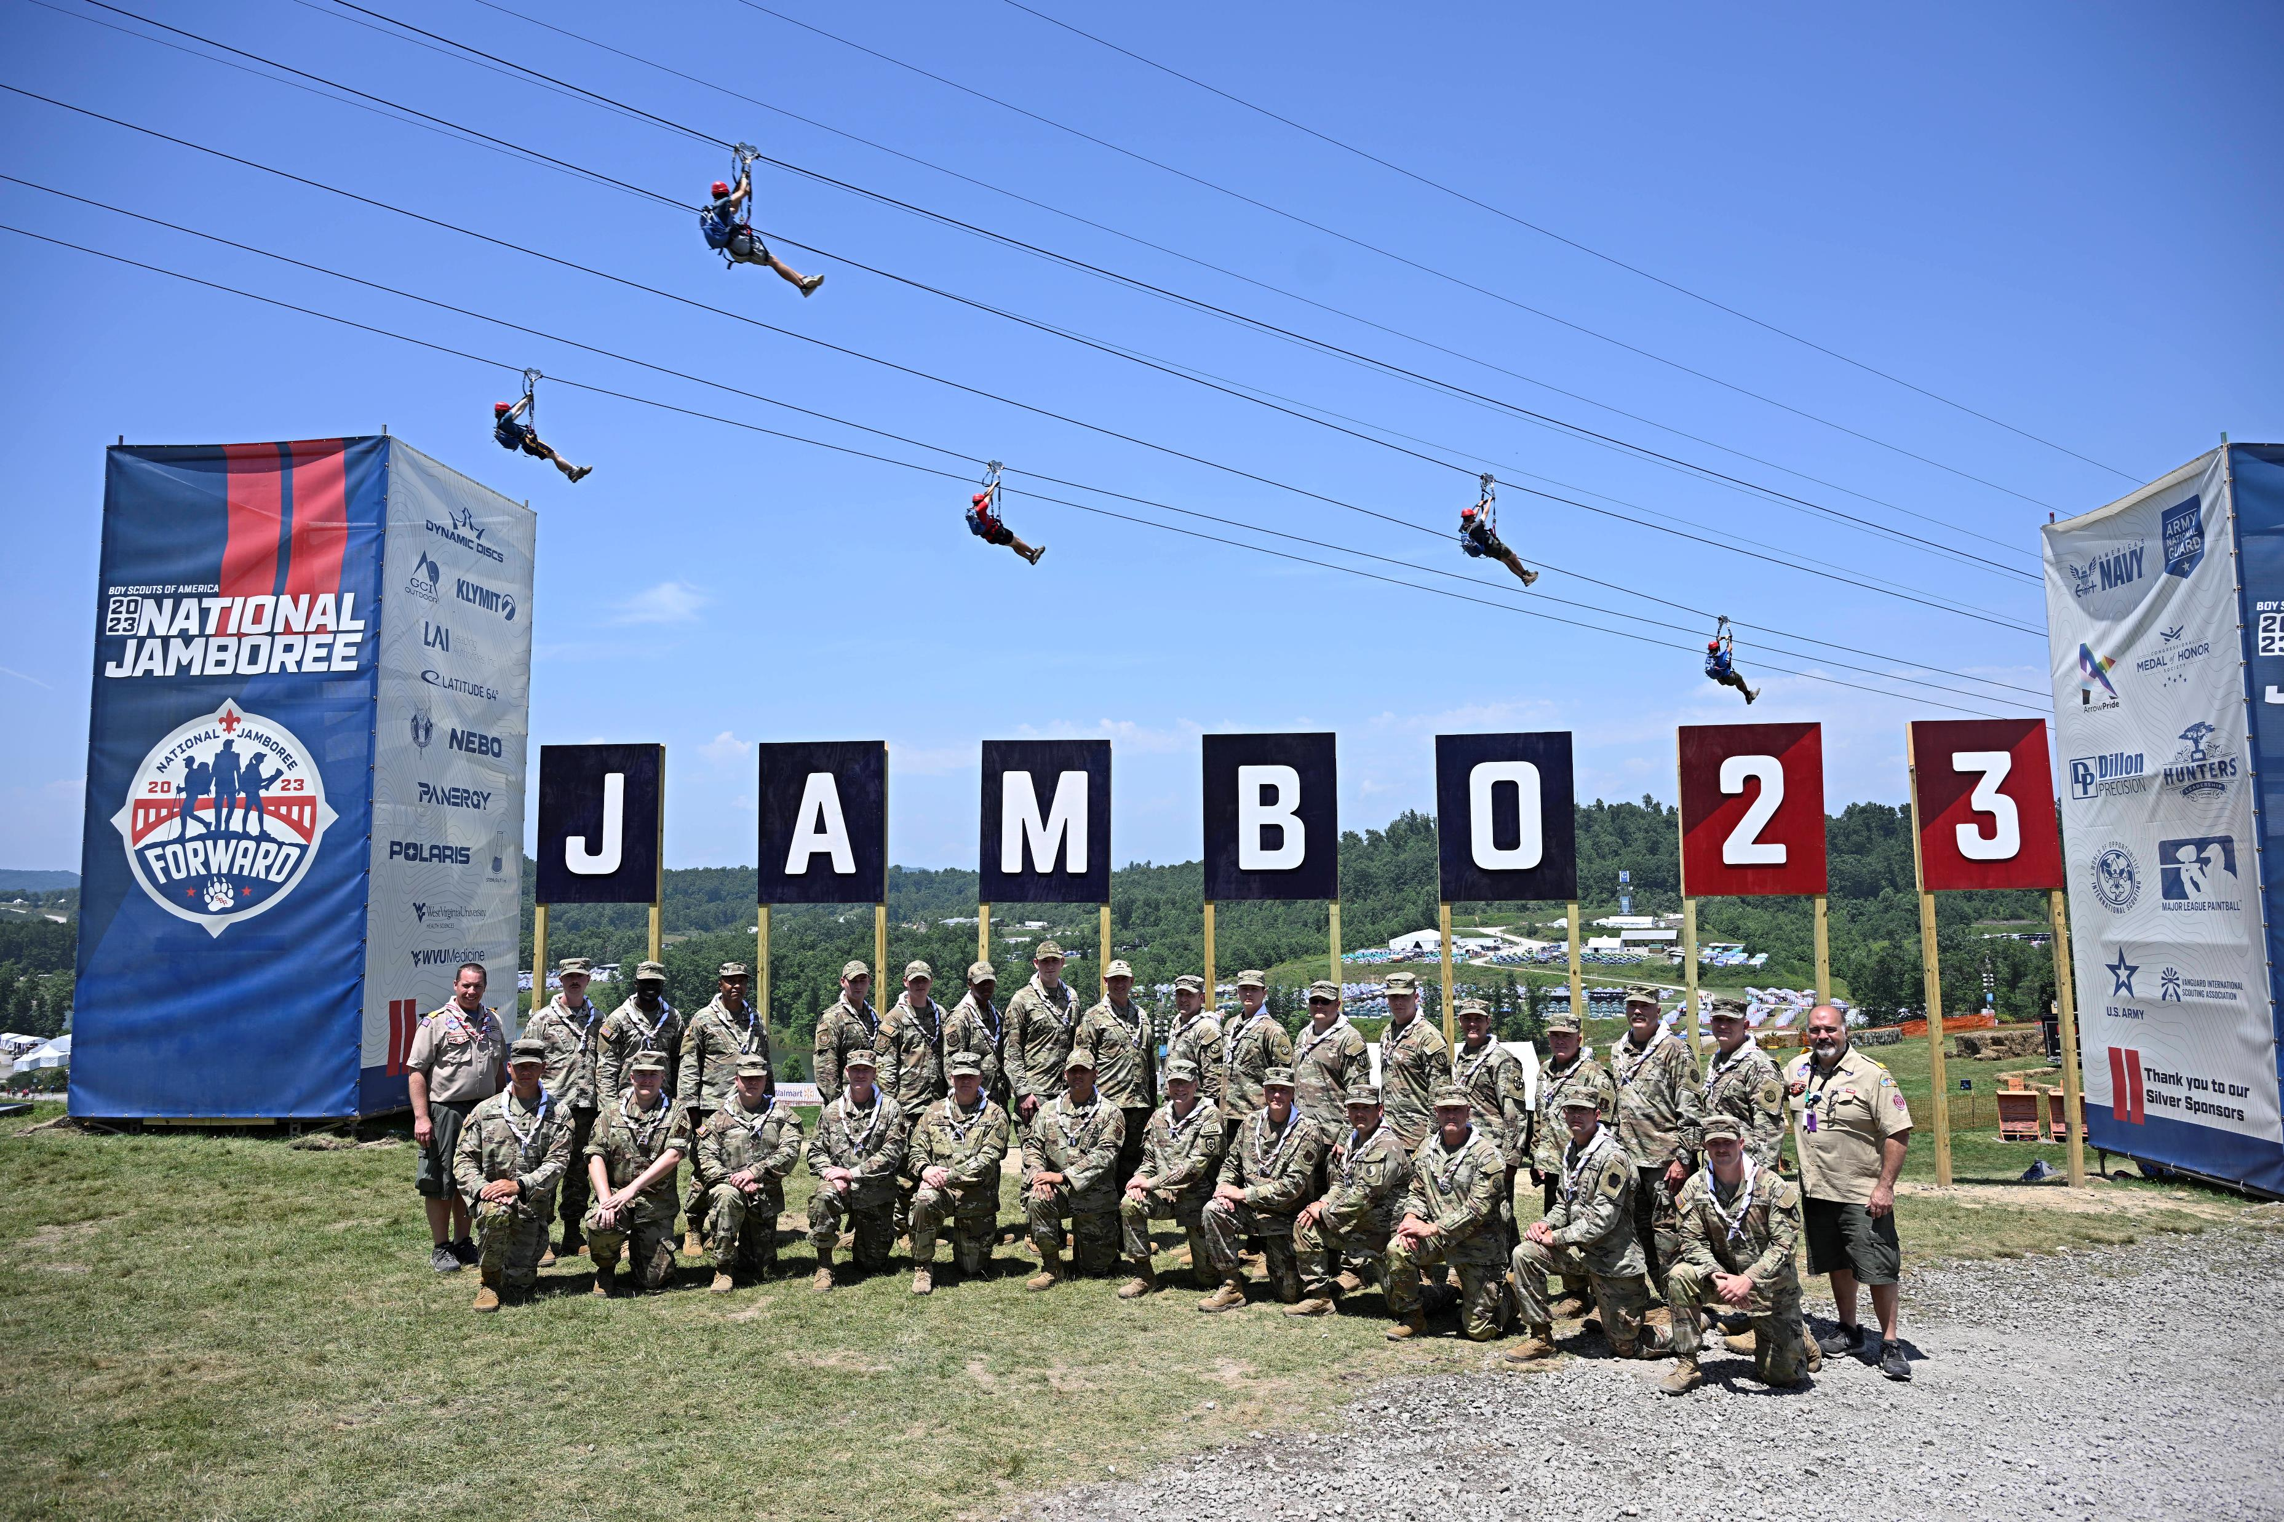
Emergency Management
Working again with the military and local, state and federal entities to develop the plans.
Always a need for security JST
Always a need for EMT and credentialed volunteers
Notes:
TP
We will once again be supported by the military and the WV National guard

Slide 14
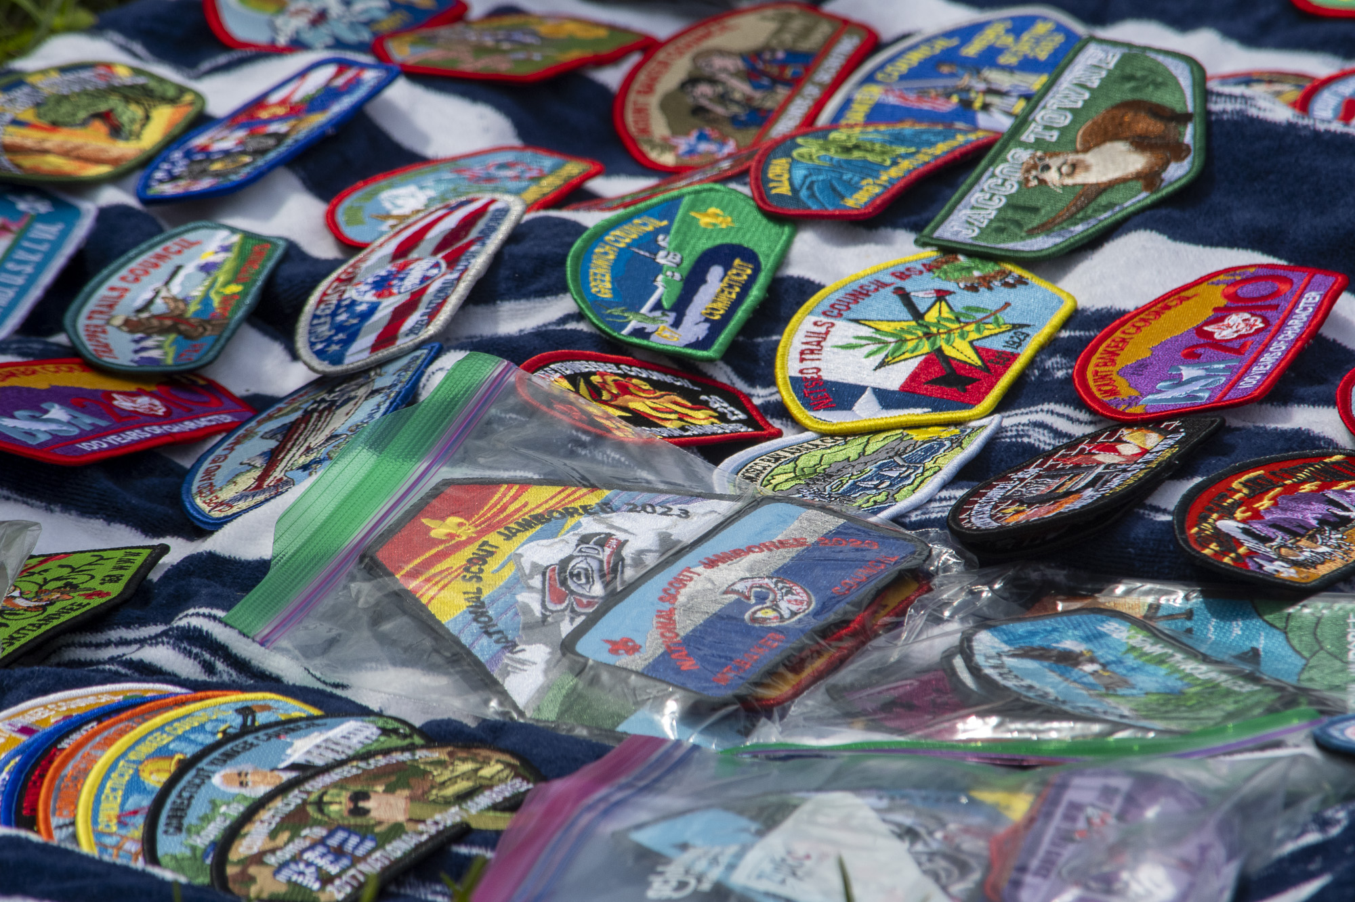
Safeguarding Youth
YPT must not expire before the Jamboree ends
We will continue to require understanding and preventing youth on youth abuse for all leaders
Notes:
Glenn
Biggest challenge in 2023 was peer to peer abuse
Need the council help to train adult leaders in peer to peer abuse prevention
All adults onsite will be required to be current in youth protection. This will include an abbreviated training for visitors

Slide 15
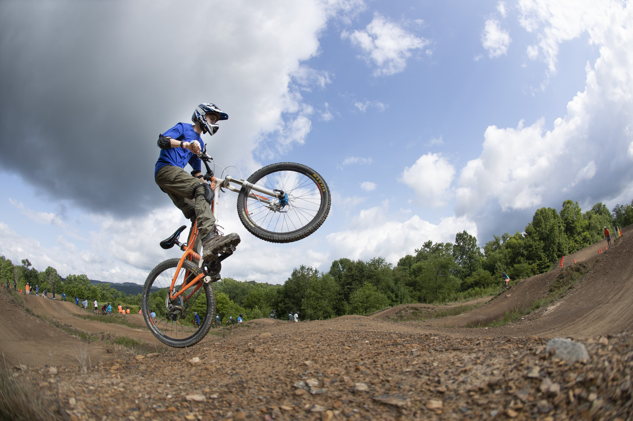
Finance
Scholarship and application to be developed and will be a part of the process after council registration.
Platinum package events and membership
Budget in development
Notes:
TP
The Platinum package membership and program will be renewed for 2026. This program was extremely effective in producing scholarship $ for youth to attend.
The scholarship process will be announced with the registration fees this fall.
We know you want to know the fee, but we are working diligently to plan a program and budget to ensure the fee will give the best Jamboree experience possible for the lowest price.

Slide 16


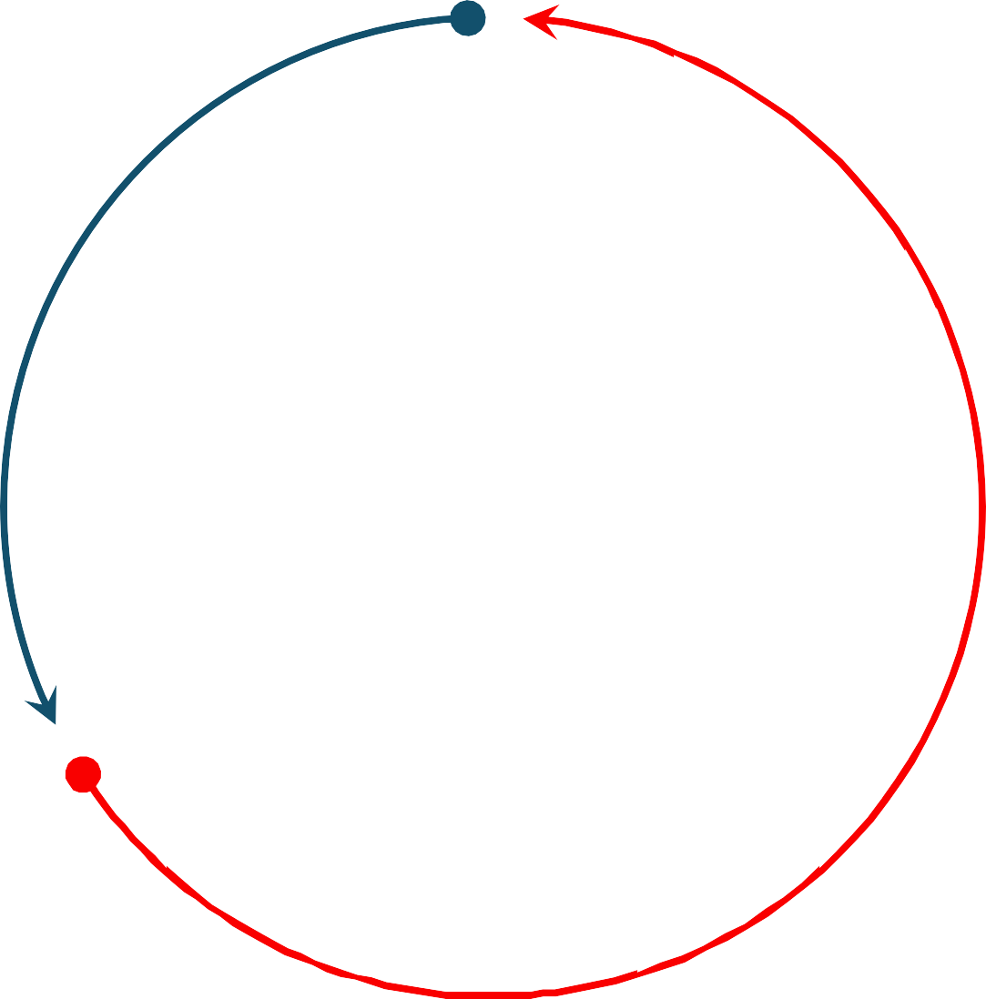


















Coordinate activities
Program
Core values
What brings joy
Balance risk and reward
Jamboree Program Vision
Knowledge of world needs
Prepare Scouts for a life of purpose and impact
Ability to inspire
Source of renewal
Self-leadership
Self-confidence
Notes:
Glenn
Explain the vision to prepare Scouts for a life of purpose and impact
These are the ways we plan do meet that objective.

Slide 17
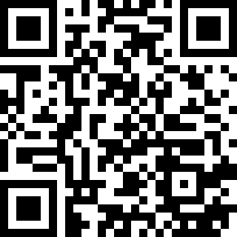
Program
Plan to have arena show(s)
Military flyovers/displays
Summit program items
Rafting will be available – no outside trips will be allowed
Tell us your ideas
Notes:
Glenn
Plan to have an opening and closing show and smaller bashes
The military is onboard to have several more displays and exhibits and flyovers
Staffing will dictate how many and what adventure programs are open/available, so help us recruit staff
Rafting will be available again through the Jamboree. No units will be allowed to leave for a rafting trip during the dates of the Jamboree unless a part of the Jamboree rafting experience. We plan to lower the rafting fee from 2023
The QR code will lead you to a google form for program ideas that you can share with us things you would like (or that your Scouts would like) to be at the Jamboree. We want to hear from you.

Slide 18
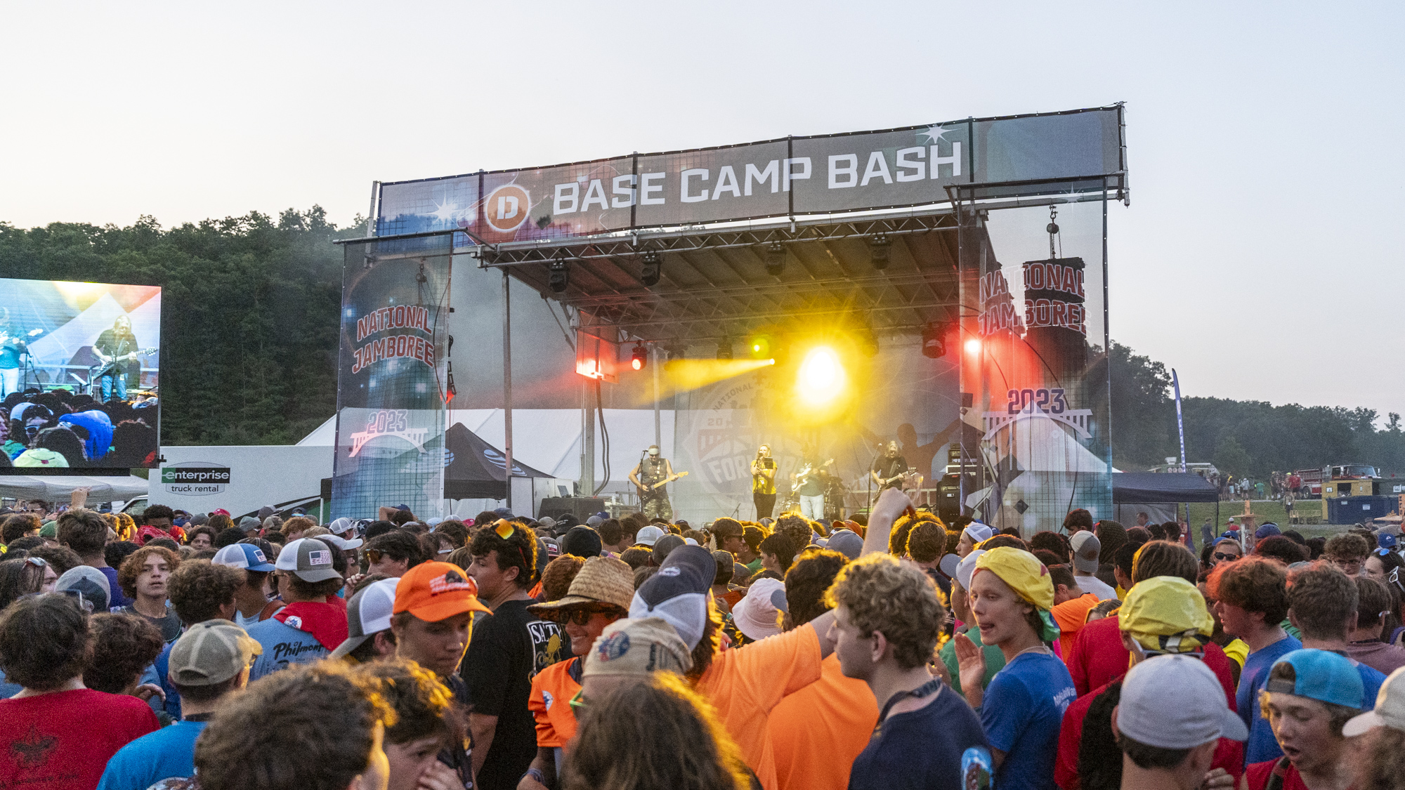
Q&A
Notes:
All

